Slide 1


husseinnasser.com
ACID
Atomicity, Consistency, Isolation and Durability in
Relational Database Systems

Slide 2
Agenda
What is a Transaction?
Atomicity
Isolation
Consistency
Durability

Slide 3
Transaction
A collection of queries
One unit of work
E.g. Account deposit (SELECT, UPDATE, UPDATE)

Slide 4
Transaction
ACCOUNT_ID | BALANCE
1 | $1000
2 | $500
$900
$900
$600
$600
Send $100 From Account 1 to Account 2
BEGIN TX1
SELECT BALANCE FROM ACCOUNT WHERE ID = 1
BALANCE > 100
UPDATE ACCOUNT SET BALANCE = BALANCE - 100 WHERE ID = 1
UPDATE ACCOUNT SET BALANCE = BALANCE + 100 WHERE ID = 2
COMMIT TX1

Slide 5
Atomicity
All queries must succeed. If one fails all should rollback.

Slide 6
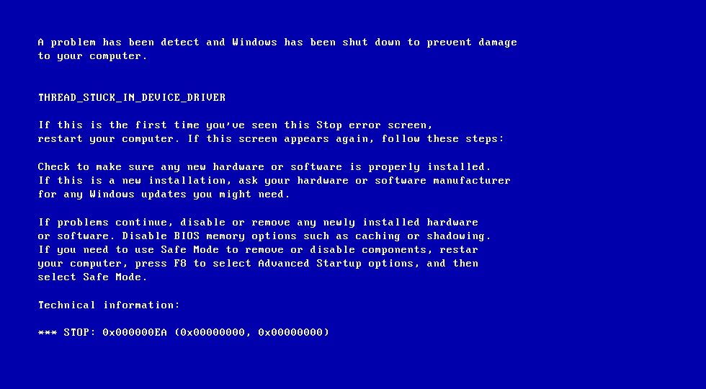
Atomicity
ACCOUNT_ID | BALANCE
1 | $1000
2 | $500
$900
Send $100 From Account 1 to Account 2
BEGIN TX1
SELECT BALANCE FROM ACCOUNT WHERE ID = 1
BALANCE > 100
UPDATE ACCOUNT SET BALANCE = BALANCE - 100 WHERE ID = 1

Slide 7
Atomicity
ACCOUNT_ID | BALANCE
1 | $900
2 | $500
After we restarted the machine the account has been debited but the other account has not been credited.
An atomic transaction is a transaction that will rollback all queries if one of the queries failed.

Slide 8
Isolation
Can my inflight transaction see changes made by other transactions?
Read phenomena
Isolation Levels

Slide 9
Isolation - Read phenomena
Dirty reads
Non-repeatable reads
Phantom reads
(Lost updates)

Slide 10
Dirty Reads
SALES
PID | QNT | PRICE
Product 1 | 10 | $5
Product 2 | 20 | $4
10
15
BEGIN TX1
BEGIN TX2
SELECT PID, QNT*PRICE FROM SALES
Product 1, 50
Product 2, 80
UPDATE SALES SET QNT = QNT+5
WHERE PID =1
SELECT SUM(QNT*PRICE) FROM SALES
$155
COMMIT TX1
ROLLBACK TX2

Slide 11
Non-repeatable read
SALES
PID | QNT | PRICE
Product 1 | 10 | $5
Product 2 | 20 | $4
15
15
BEGIN TX1
BEGIN TX2
SELECT PID, QNT*PRICE FROM SALES
Product 1, 50
Product 2, 80
UPDATE SALES SET QNT = QNT+5
WHERE PID =1
COMMIT TX2
SELECT SUM(QNT*PRICE) FROM SALES
$155
COMMIT TX1

Slide 12
Phantom read
SALES
PID | QNT | PRICE
Product 1 | 10 | $5
Product 2 | 20 | $4
BEGIN TX1
Product 3 | 10 | 1
Product 3 | 10 | $1
SELECT PID, QNT*PRICE FROM SALES
BEGIN TX2
Product 1, 50
Product 2, 80
INSERT INTO SALES
VALUES (‘Product 3’, 10, 1)
COMMIT TX2
SELECT SUM(QNT*PRICE) FROM SALES
$140
COMMIT TX1

Slide 13
Isolation - Isolation Levels for inflight transaction
Read uncommitted
No Isolation, any change from the outside is visible to the transaction
Read committed
Each query in a transaction only sees committed stuff
Repeatable Read
Each query in a transaction only sees committed updates at the beginning of transaction
Serializable
Transactions are serialized.

Slide 14
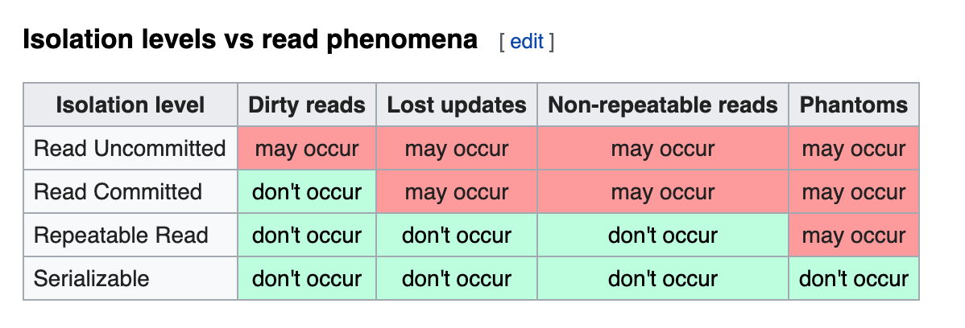
Isolation Levels vs read phenomena
https://en.wikipedia.org/wiki/Isolation_(database_systems)

Slide 15
Consistency
Consistency in Data
Consistency in reads

Slide 16
Consistency in Data
Defined by the user
Referential integrity (foreign keys)
Atomicity
Isolation

Slide 17
Consistency in Data
Pictures
Picture_Likes
ID (PK) | BLOB | LIKES
1 | xx | 2
2 | xx | 1
USER (PK) | PICTURE_ID (PK)(FK)
Jon | 1
Edmond | 1
Jon | 2

Slide 18
Consistency in reads
Update X
X
Read
X

Slide 19
Consistency in reads
If a transaction committed a change will a new transaction immediately see the change?
Relational and NoSQL databases suffer from this
Eventual consistency

Slide 20
Durability
Committed transactions must be persisted in a durable non-volatile storage.

Slide 21
Summary
What is a Transaction?
Atomicity
Isolation
Consistency
Durability

